Slide 1
Practice changing advances in gastric cancer
ESMO2025
Dr MANAL kahwahji
Head of GI unit
Al birouny Hospital

Slide 2


Slide 3
Perioprative settings
ADC Revolution
Biomarker_Driven personalization
Front line options

Slide 4
Perioperative setting
KEYNOTE 585
MATTERHORN

Slide 5
KEYNOTE 585

Slide 6
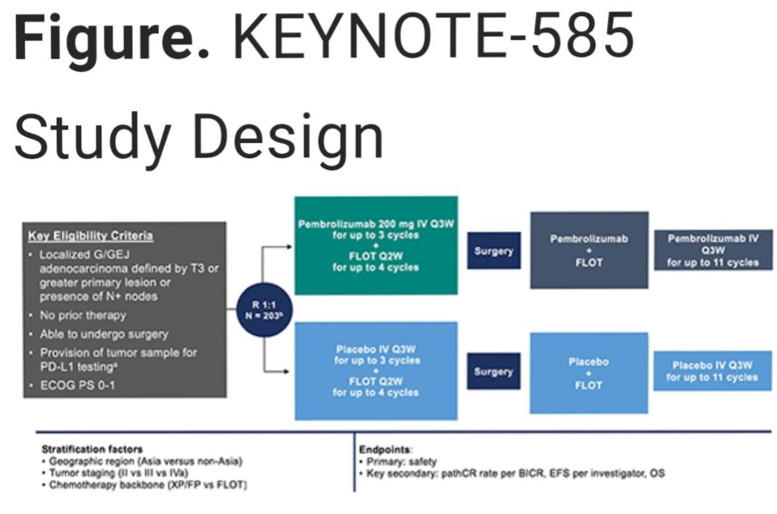

Slide 7
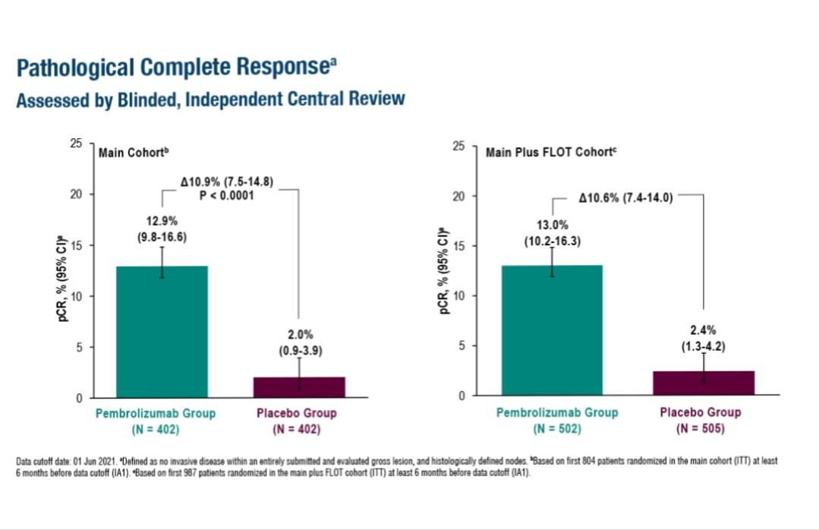

Slide 8
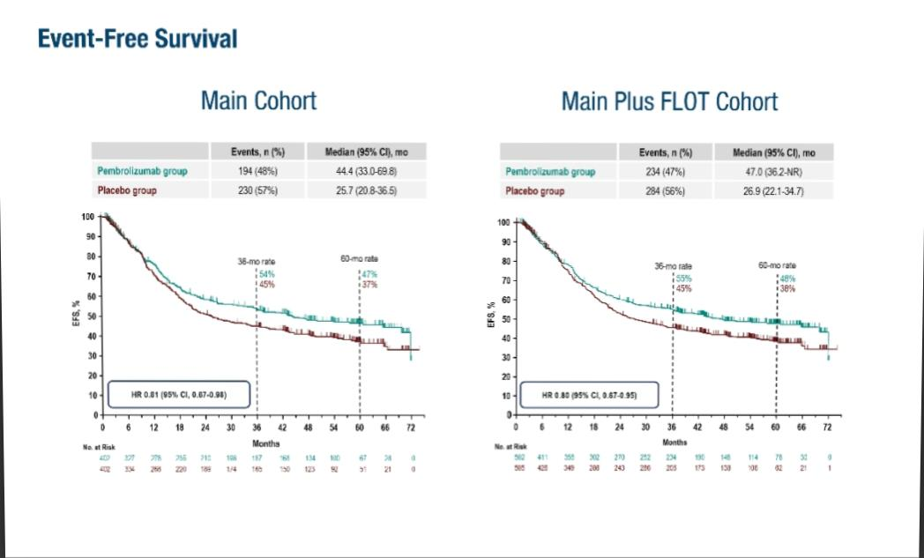

Slide 9
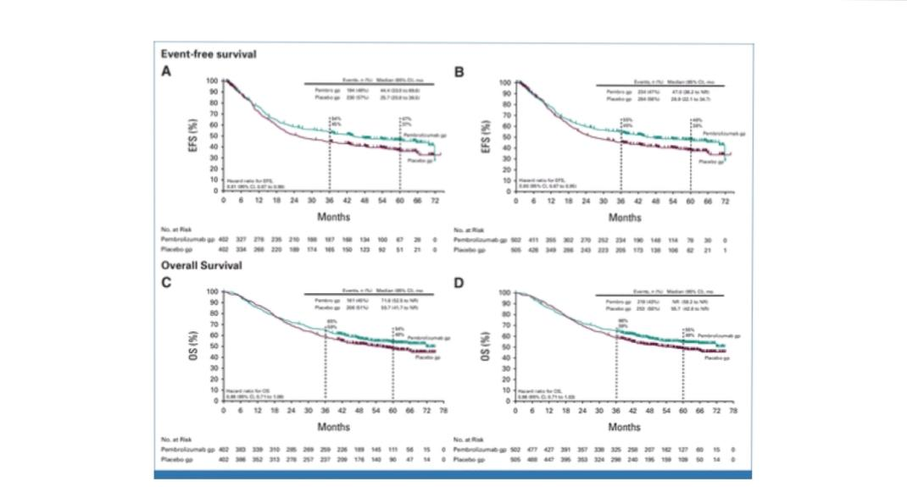

Slide 10
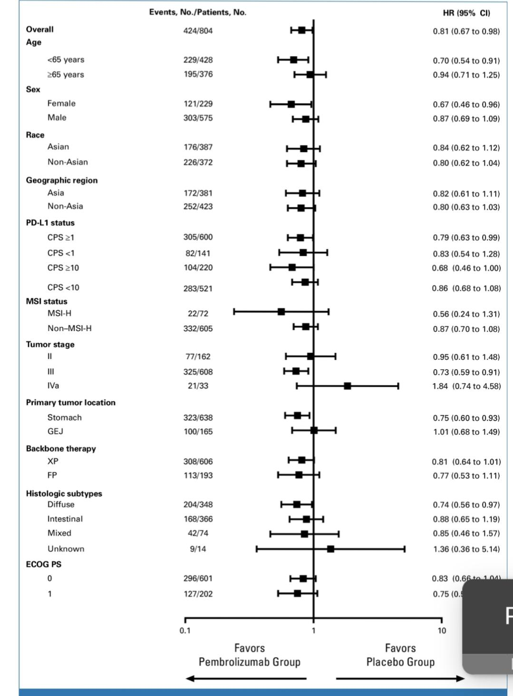

Slide 11
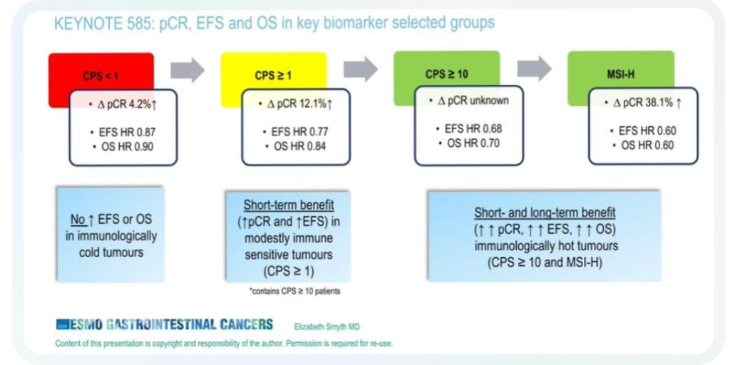

Slide 12
Conclusion
Perioperative Pembrolizumab+FLOT. Demonstrate statistically significant pCR and clinically meaningful improvement in EFS and OS

Slide 13
MATTERHORN

Slide 14
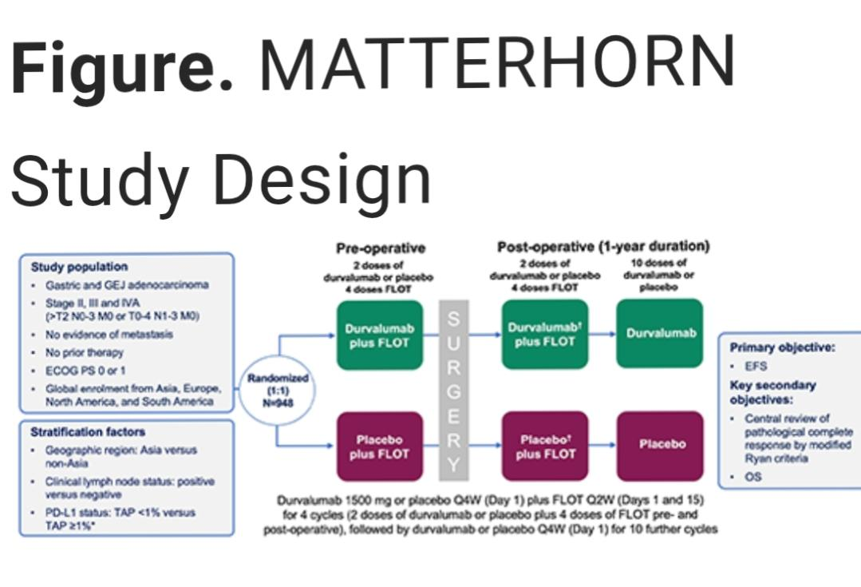

Slide 15
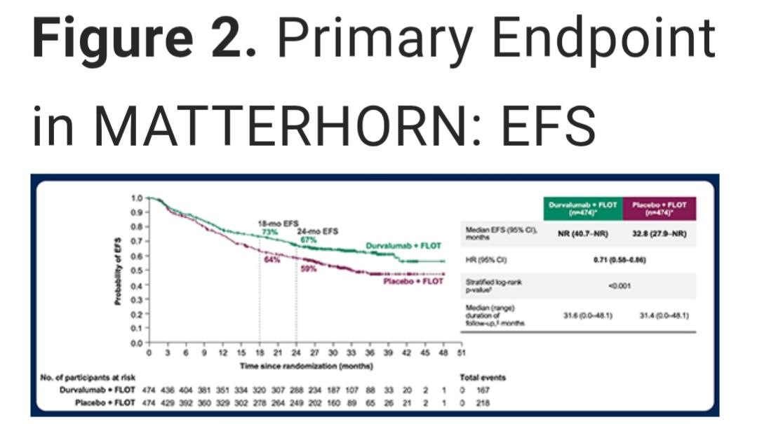

Slide 16
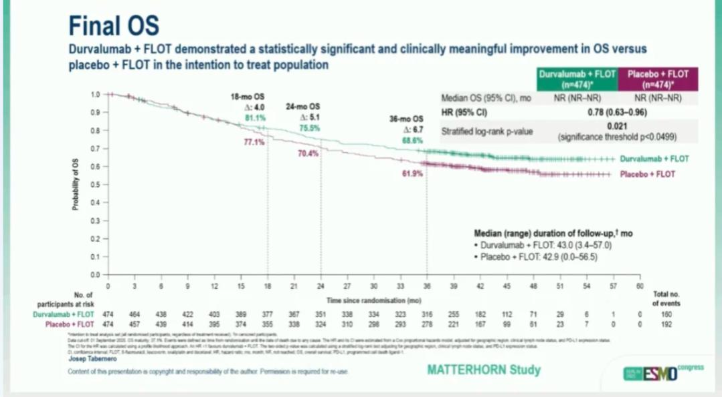

Slide 17
MATTERHORN
pCR was 19% in D+FLOT arm vs. 7% in placebo arm

Slide 18
Conclusion
MATTERHORN data solidifies the role of perioperative anti PD1/PDL1 therapy +FLOT as a new global standard

Slide 19
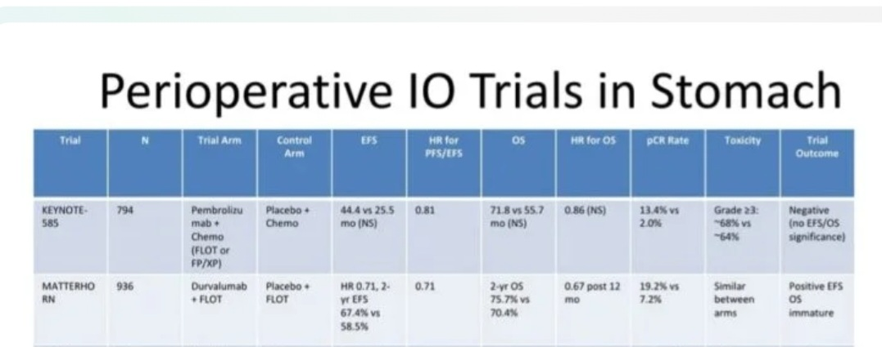

Slide 20
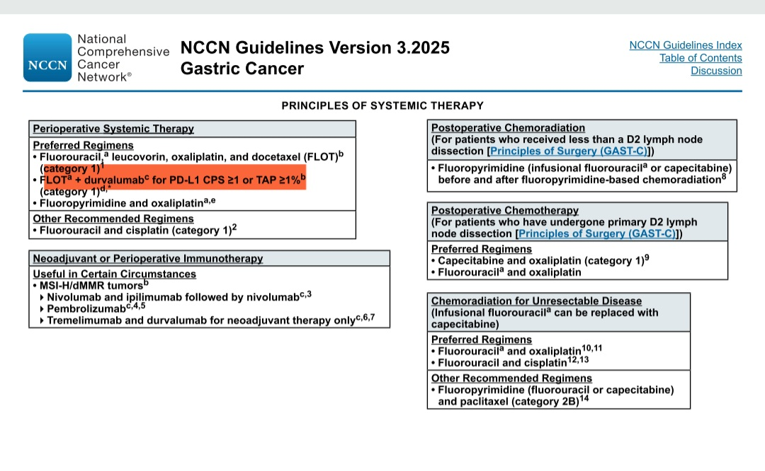

Slide 21
Role oF ctDNA
Patient compleats perioperative therapy

Slide 22
Role oF ctDNA
Patient compleats perioperative therapy
Perform ctDNA

Slide 23
Role oF ctDNA
Patient compleats perioperative therapy
Perform ctDNA
NEGATIVE: Favorable prognosis Active Surveillance

Slide 24
Role oF ctDNA
Patient compleats perioperative therapy
Perform ctDNA
NEGATIVE: Favorable prognosis Active Surveillance
POSITIVE: High risk for recurrence intensive Surveillance or
trials

Slide 25
ctDNA has a prognostic importance

Slide 26
ADVANCED and METASTATIC GASTRIC CANCER
Personalising 1st line therapy
HER2 | Positive | Chem+trustuzumab+Pembrolizumab(if PDL1 positive)
CLDN18.2. | Positive Ihc>75 | Zolbetuximab+chemo
PDL1 CPS | >5 and HER2/CLDN18.2 neg | Chemo +Nivolumab/pembrolizumb

Slide 27
Biomarker test at diagnosis is MANDATORY

Slide 28
Evolving ADC Landscape in Later Line Therapy
HER2 POSITIVE
T-DXd
HER2 LOW

Slide 29
ADC on The Horizon
Ifinatamab Deruxtecan : Anti B7-H3 is a promising activity in Tripple negative disease
Anti-Fra ADC in selected Fra high patients

Slide 30


